Slide 1






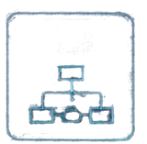
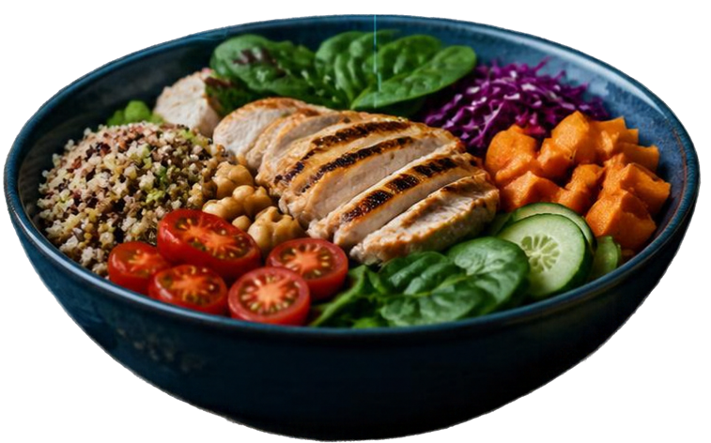
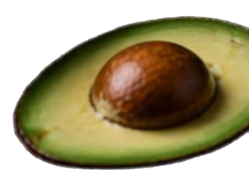


NUTRIENT PROFILE
Carbs
Protein
Fats
Fiber
NutriGuide AI
CALORIE BALANCE
1830 kcal
AI
PERSONALIZED PLAN
Balanced High Fiber Low Sugar
A Rule-Based Artificial Intelligence /
Expert System for Personalized Diet Planning
RULE-BASED ENGINE
Team Members: Ragavi N (240701407)
Preethi K N (240701398)
Department: CSE
College: Rajalakshmi Engineering College
Academic Year: 2026

Slide 2

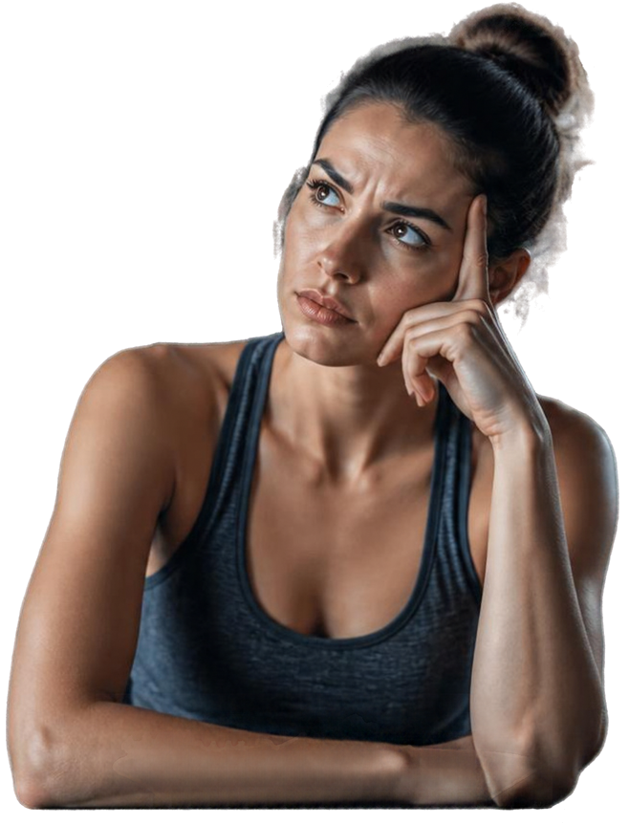


ABSTRACT / PROBLEM STATEMENT
One-size-fits-all
diet plans don’t work.
People differ in age, body metrics, and activity level
Preferences, allergies, and health conditions vary
Generic plans miss the nuances that drive results
Lack of personalization leads to poor adherence
NutriGuide AI uses expert knowledge and IF–THEN rules
to create personalized diet plans.
Explainable. Adaptable. Built for you.

Slide 3

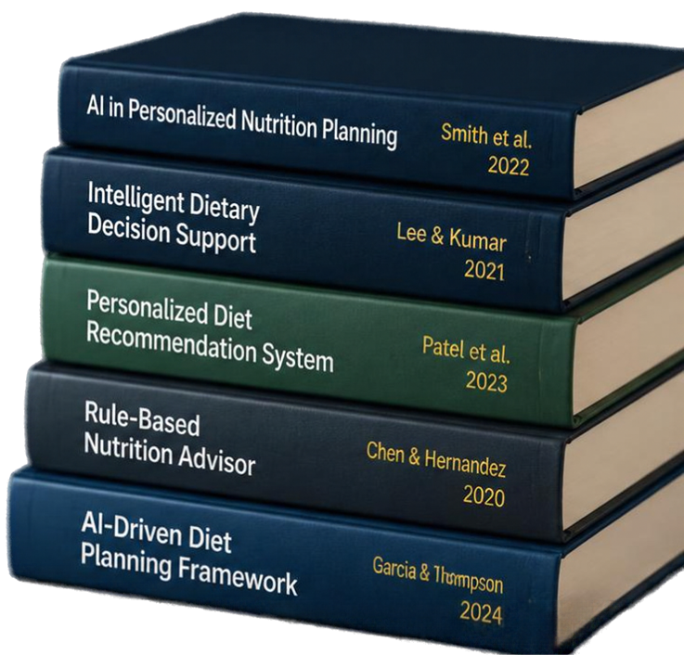


LITERATURE SURVEY
Key research shaping AI-powered diet planning
Five studies show rule-based systems can personalize nutrition, explain recommendations, and improve adherence.
Common gaps include scalability, limited health coverage,
allergy rules, meal variety, and real-time performance.
These insights drive NutriGuide AI — a rule-based, expert system focused on explainability and true personalization.

Slide 4














SYSTEM ARCHITECTURE
01
User Input
Collect personal data & preferences
A rule-based intelligence engine.
02
User Profile & Requirements
Structured user attributes & goals
03
Knowledge Base + Rule Base
Nutrition facts & dietary rules
IF–THEN expert rules
04
Inference Engine
Applies rules to user data
NutriGuide AI combines expert knowledge with rule-based reasoning to deliver personalized, explainable diet plans.
05
Diet Recommendation Engine
Generates meal plans
Intelligence derives from knowledge representation
and rule-based inference.
06
Personalized Diet Plan
Tailored plan for the user
07
Personalized, explainable
recommendations
Explanation / Recommendation Output

Slide 5












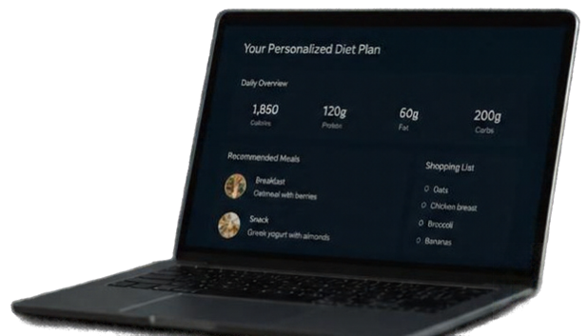


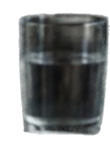


IMPLEMENTATION WORKFLOW
From user input to personalized diet plan.
01
02
03
04
05
06
07
08
09
Collect user data on
profile,
activity and preferences
Calculate BMI and basic nutritional requirements
Build knowledge base with nutrition and constraints
Define expert rules to
encode nutrition logic
Inference engine applies rules to user data
Select meals and generate recommend-ations
Create and format personalized diet plan
Store user profiles and
diet plans securely
Deliver plan
and insights through an intuitive
interface
Database / Storage
User Interface
Securely saves user data, knowledge base and personalized plans
Simple input collection and clear plan presentation

Slide 6


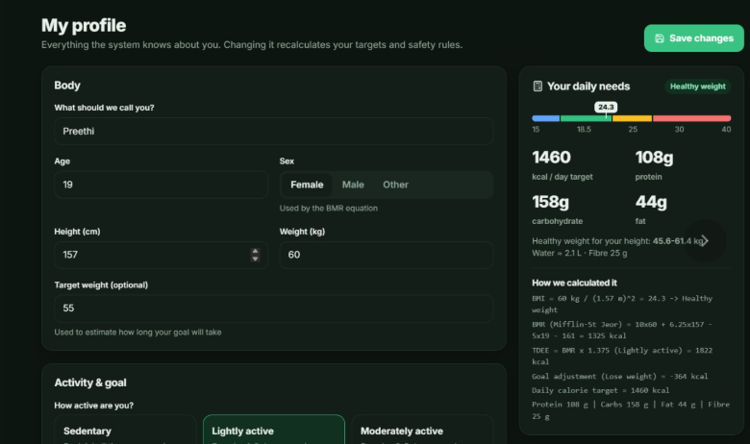

MODULE 1
User Profile & Requirement Analysis
Capture and structure personal data to drive tailored diet plans.
Collects demographic and health details
Records activity levels, goals, and preferences
Validates and organizes data for accurate insights
Enables personalized rule evaluation

Slide 7

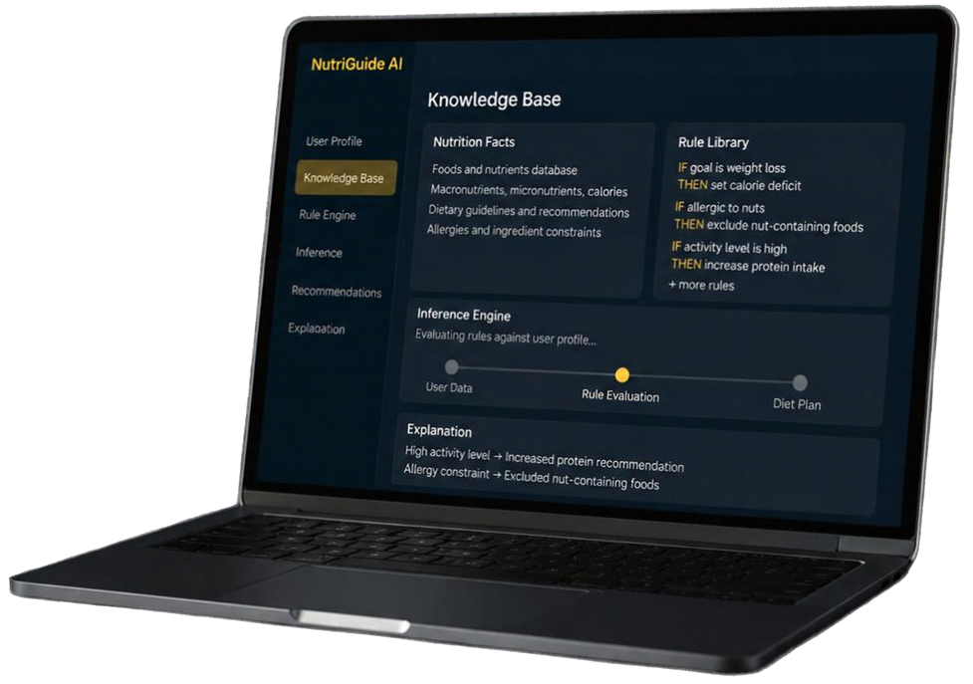
MODULE 2
Knowledge Base & Rule-Based Inference
Store expert nutrition knowledge and apply rules to user data
Maintains comprehensive nutrition facts and dietary constraints
Encodes expert knowledge as IF–THEN rules
Inference engine evaluates rules
against user profile
Enables explainable, consistent
decision-making

Slide 8


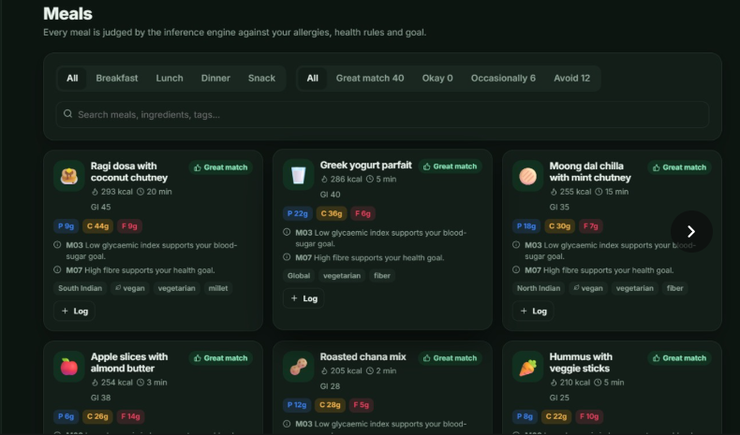
MODULE 3
Personalized Diet Plan Generation
Creates customized diet plans
based on inference results
Selects meals that meet nutritional and user-specific needs
Balances macro- and micronutrients using expert rules
Delivers clear, actionable diet recommendations
Supports plan export and
user feedback

Slide 9



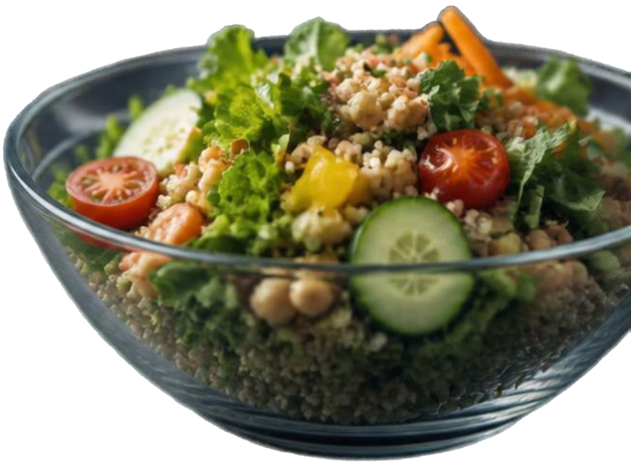


Conclusion &
Future Enhancements
CONCLUSION
Personalized diet recommendations using classical AI and rule-based reasoning
Explainable outputs grounded in user inputs and expert knowledge
Avoids ML/DL—relies on structured knowledge base and inference rules
FUTURE ENHANCEMENTS
Mobile application development
Integration with fitness trackers and wearable devices
Expansion of nutrition knowledge base
Linking with verified nutrition databases
More personalized meal alternatives
Multilingual support
Voice-based interaction for accessibility

Slide 10

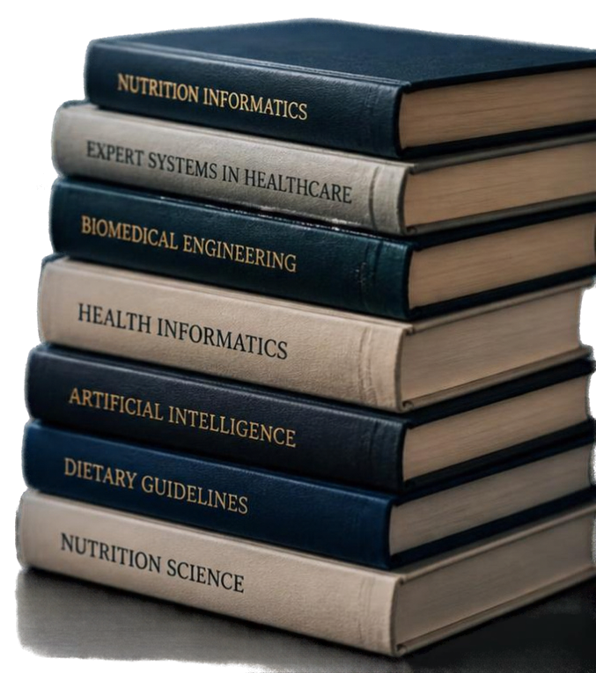
References
J. Smith, A. Brown, and M. Davis, "AI in Personalized Nutrition Planning," Journal of Nutrition Informatics, vol. 15, no. 3, pp. 45–58, 2022.
K. Lee and S. Kumar, "Intelligent Dietary Decision Support Systems," Expert Systems with Applications, vol. 42, no. 7, pp. 3107–3115, 2021.
R. Patel, L. Wang, and T. Chen, "Personalized Diet Recommendation System Using Rule-Based Inference," IEEE Transactions on Biomedical Engineering, vol. 70, no. 1, pp. 120–130, 2023.
Y. Chen and M. Hernandez, "Rule-Based Nutrition Advisor for Dietary Management," Proceedings of the International Conference on Health Informatics, pp. 85–92, 2020.
M. Garcia and H. Thompson, "AI-Driven Diet Planning Framework with Knowledge Representation," ACM Computing Surveys, vol. 56, no. 4, pp. 78-178:25, 2024.
World Health Organization, "Healthy Diet Fact Sheet," 2023. [Online]. Available: https://www.who.int/news-room/fact-sheets/detail/healthy-diet
National Institute of Nutrition, "Dietary Guidelines for Indians," 2022.
A. Kumar et al., "Design and Development of Expert Systems for Healthcare Applications," International Journal of Computer Applications, vol. 180, no. 12, pp. 23-29, 2021.

